Slide 1


CNPC Niger Petroleum S.A.
Computer Basics
CNPC Niger Petroleum S.A. CNPC Global Solutions Co. Ltd

Slide 2

Training Agenda
Lecture 1 : Hardware Basics, Outlook & MS Word
Lecture 2 : MS Excel, PowerPoint & ERP

Slide 3

Training Objectives
After finalizing this training you should be able to
Computer Hardware: Identify components, connect peripherals, and perform basic troubleshooting.
Word: Apply consistent formatting (styles, headers) and use Track Changes.
Outlook: Write professional emails, organize their inbox, and manage their calendar.
Excel: Use essential formulas, sort/filter data, and create basic charts.
PowerPoint: Create clean, professional slides and insert objects (images, charts).
ERP: Define what an ERP system is and explain its purpose in the business.

Slide 4

Test your Knowledge
Please scan the QR code here or go to the below website:
https://afathelbab.github.io/cnpc/computer-basics-soft-skills/day3/quiz.html

Slide 5
Quiz Reflection
How many got the full mark?
How got more than 50% correct?
How many got them all wrong?
It’s OK either way

Slide 6
Module 1:
Excel Essentials

Slide 7


Module 1: Excel Essentials
What is Excel For?
Excel is a spreadsheet program. You'll use it for:
Organizing data
Performing calculations
Visualizing trends

Slide 8

Module 1: Excel Essentials
Essential Formulas
Formulas are the heart of Excel. They always start with an equals sign (=)
=SUM(A1:A10): Adds all the numbers in a range of cells (from A1 to A10)
=AVERAGE(B1:B10): Calculates the average of the numbers in that range
=COUNT(C1:C10): Counts how many cells in that range contain numbers
=IF(condition, value_if_true, value_if_false): Performs a logical test
Example: =IF(A2 > 100, "Yes", "No")
Translation: If the value in cell A2 is greater than 100, show "Yes". Otherwise, show "No".

Slide 9


Module 1: Excel Essentials
Essential Formulas
This helps you find what you need in large datasets.
Sort: Select your data, go to the Data tab, and click Sort. You can organize your data alphabetically (A-Z), numerically (Smallest to Largest), etc.
Filter: Select your data, go to the Data tab, and click Filter. This adds a small dropdown arrow to each column header, allowing you to show only the rows that meet your criteria (e.g., show only equipment in a specific unit).

Slide 10

Module 1: Excel Essentials
Creating Basic Charts
Visualizing data makes it much easier to understand.
Select Your Data: Highlight the cells you want to include (e.g., a column of dates and a column of sales figures).
Go to Insert: Click the Insert tab.
Choose a Chart: Select a Bar Chart, Pie Chart, or Line Chart from the "Charts" section. Excel will create it for you instantly.
Add Titles: Always give your chart a clear title and label your axes (what the horizontal and vertical lines represent).

Slide 11

Module 1: Excel Essentials
Open Discussion
When would an IF formula be more useful than just SUM?
Why is filtering data often more helpful than just sorting it?

Slide 12
Module 2:
PowerPoint Fundamentals

Slide 13

Module 2: PowerPoint Fundamentals
Creating Clean & Professional Slides
The goal of a presentation is to support your speaking, not to be a script. Less is more.
One Idea Per Slide: Don't crowd a slide with 10 different points. Keep it focused.
Use Keywords, Not Sentences: Use short bullet points (3-5 per slide is a good rule). Your audience should be listening to you, not reading your slides.
Use a Slide Master: (View > Slide Master) This allows you to set the font, logo, and colors for all your slides at once. It ensures your presentation looks consistent and professional.
High-Contrast & Readable Font: Use a simple, clean font (like the one you're reading now) and make sure it's large enough. Black text on a white background is always safe.

Slide 14
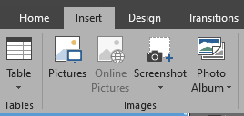
Module 2: PowerPoint Fundamentals
Inserting Objects
Slides are visual. Use objects to break up text.
Images: Go to Insert > Pictures. Use high-quality images that are relevant to your point. Don't stretch or distort them!
Charts from Excel: You can copy a chart in Excel (Ctrl+C) and paste it directly into PowerPoint (Ctrl+V).
It's often best to paste it "As Picture" to prevent formatting issues, or "Link Data" if you want the chart in PowerPoint to update when you change the data in Excel.

Slide 15
Module 2: PowerPoint Fundamentals
Open Discussion
What's the biggest mistake you've seen in a presentation? (e.g., too much text, bad colors, unreadable font)
Why is it important to have a consistent look (using a Slide Master) for all slides?

Slide 16
Module 3:
Introduction to ERP Systems

Slide 17

Module 3: Introduction to ERP Systems
What is an ERP System?
ERP stands for Enterprise Resource Planning.
At its simplest, an ERP is a single, centralized software system that manages all of a company's key business processes.
It acts as the "central nervous system" for the entire business

Slide 18
Module 3: Introduction to ERP Systems
What is an ERP System?
Think about all the different departments in our company:
Operations (manages well sites, production schedules)
Maintenance (handles work orders, equipment repair)
Supply Chain (handles inventory, ordering parts, shipping)
Finance (handles billing, payments, accounts)
HR (handles employee info, payroll, hiring)
HSE (handles safety permits, incident reporting)
In the past, each department might have used its own separate software. This creates "silos," where data is hard to share, must be manually re-entered, and quickly becomes out-of-date.

Slide 19
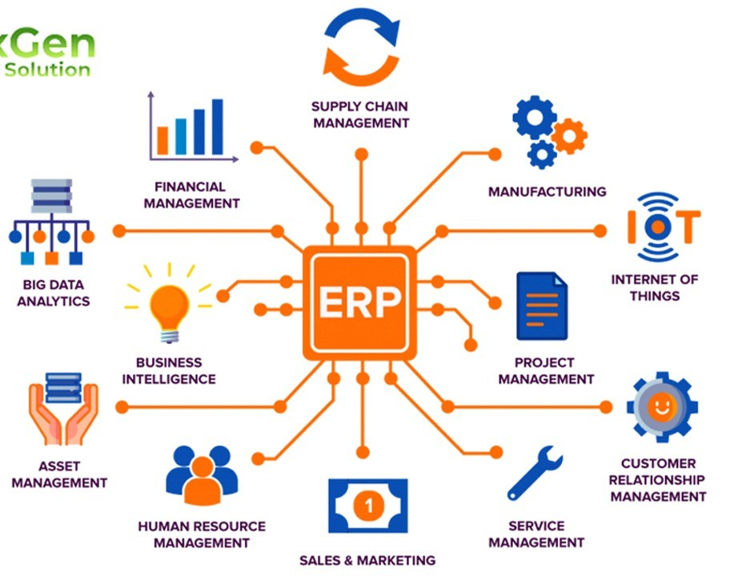
Module 3: Introduction to ERP Systems
The Purpose of an ERP: A Single Source of Truth
The main purpose of an ERP system is to break down those silos.
It creates a "single source of truth" by having all departments use one shared, central database.
When everyone uses the same system, data is shared in real-time.

Slide 20
Module 3: Introduction to ERP Systems
The Purpose of an ERP: A Single Source of Truth
Let's trace a single maintenance task to see how the ERP connects everyone from the field to the warehouse.
We'll use a "Procure-to-Pay" example.

Slide 21
Module 3: Introduction to ERP Systems
How an ERP Works: (Procure-to-Pay)
Let's trace a single maintenance task to see how the ERP connects everyone from the field to the warehouse.
We'll use a "Procure-to-Pay" example.

Slide 22
Module 3: Introduction to ERP Systems
How an ERP Works: (Procure-to-Pay)
Maintenance:
A supervisor inspects a pump (P-101) and sees it needs a new strainer. They create a purchase requisition in the ERP for that specific part number.

Slide 23
Module 3: Introduction to ERP Systems
How an ERP Works: (Procure-to-Pay)
Procurement (Supply Chain):
The requisition is automatically routed to the procurement team. They see the request, check the system, and confirm the part is not in the warehouse. They issue a Purchase Order (PO) to an approved vendor.

Slide 24
Module 3: Introduction to ERP Systems
How an ERP Works: (Procure-to-Pay)
Warehouse (Supply Chain):
The vendor delivers the part. The warehouse team receives it, scans it, and marks it as "Goods Received" in the ERP. The system inventory is immediately updated.

Slide 25
Module 3: Introduction to ERP Systems
How an ERP Works: (Procure-to-Pay)
Finance:
The "Goods Received" status, matched with the vendor's invoice, automatically triggers the ERP to approve the payment. Finance doesn't have to ask maintenance if the part arrived—they know.

Slide 26
Module 3: Introduction to ERP Systems
How an ERP Works: (Procure-to-Pay)
Maintenance (Again):
The supervisor who made the request now sees the part is "In Stock" and can create a Work Order to have it installed.
Everyone is working from the same, up-to-date information.

Slide 27
Module 3: Introduction to ERP Systems
Benefits of an ERP
Efficiency: No more re-typing data from one system into another.
Accuracy: Reduces errors by having one source for all data.
Better Reporting: Managers can see a complete picture of the business in one place.
Consistency: A customer gets the same information no matter which department they talk to.

Slide 28
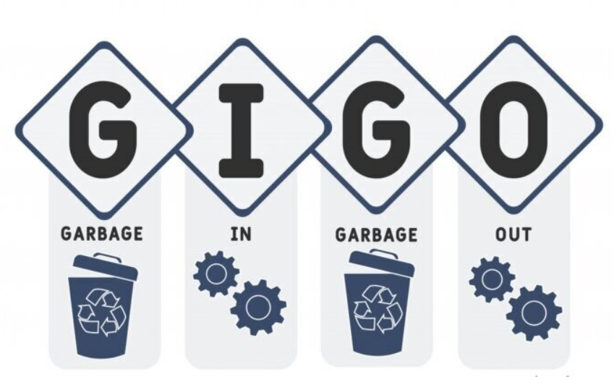
Module 3: Introduction to ERP Systems
The GIGO Effect
The ERP is only as good as the data put into it.
A single typo in a part number, a Well ID, or a dollar amount can cause major problems for many other departments (e.g., ordering the wrong part, billing to the wrong project).
Your responsibility, any time you use the ERP, is to be accurate and timely. Double-check your entries.
The "single source of truth" depends on every single user.

Slide 29
Module 3: Introduction to ERP Systems
Open Discussion
Why is having a "single source of truth" for data so important for a growing business?
Before ERPs, what kind of problems might a company have if Sales, Finance, and Shipping all used different software?

Slide 30
Test your Knowledge
Again!
Please scan the QR code here or go to the below website:
https://afathelbab.github.io/cnpc/computer-basics-soft-skills/day3/quiz.html

Slide 31



A Better You, A Better Niger
74

Slide 32
Backup Slides

Slide 33
Workshop

Slide 34


Workshop
https://afathelbab.github.io/cnpc/computer-basics-soft-skills/workshops/

